Slide 1
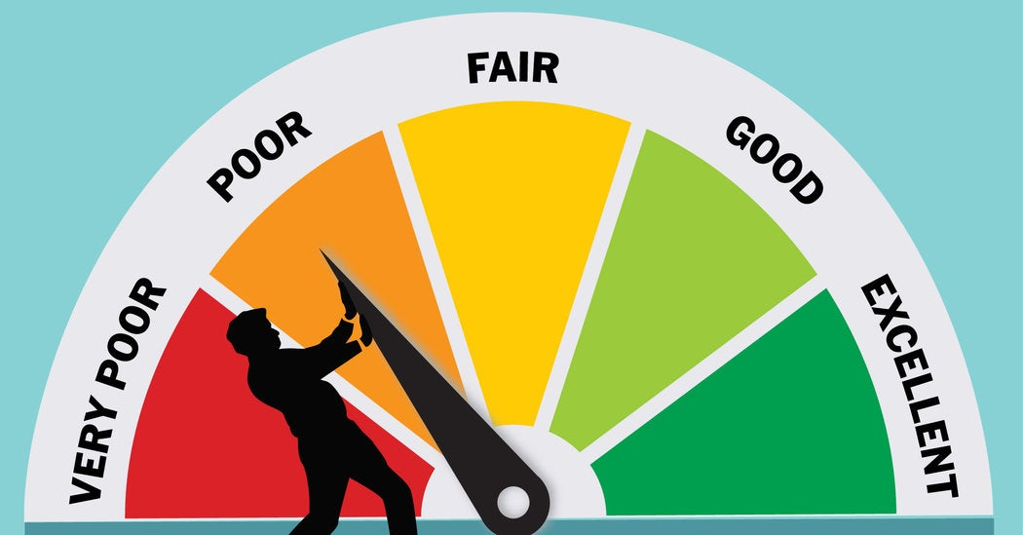
RATINGS PREDICTION PROJECT
Submitted By:
Lakshmi Rajendra Thute

Slide 2

INTRODUCTION
We have a client who has a website where people write different reviews for technical products. Now they are adding a new feature to their website i.e. The reviewer will have to add stars(rating) as well with the review. The rating is out 5 stars, and it only has 5 options available 1 star, 2 stars, 3 stars, 4 stars, 5 stars. Now they want to predict ratings for the reviews which were written in the past and they do not have a rating. So, we must build an application which can predict the rating by seeing the review.
We must scrape at least 20000 rows of data. We can scrape more data as well, more the data better the model in this section we need to scrape the reviews of different laptops, Phones, Headphones, smart watches, Professional Cameras, Printers, Monitors, Home theatre, Router from different ecommerce websites. Basically, we need these columns1) reviews of the product. 2) rating of the product. We can fetch other data as well.

Slide 3
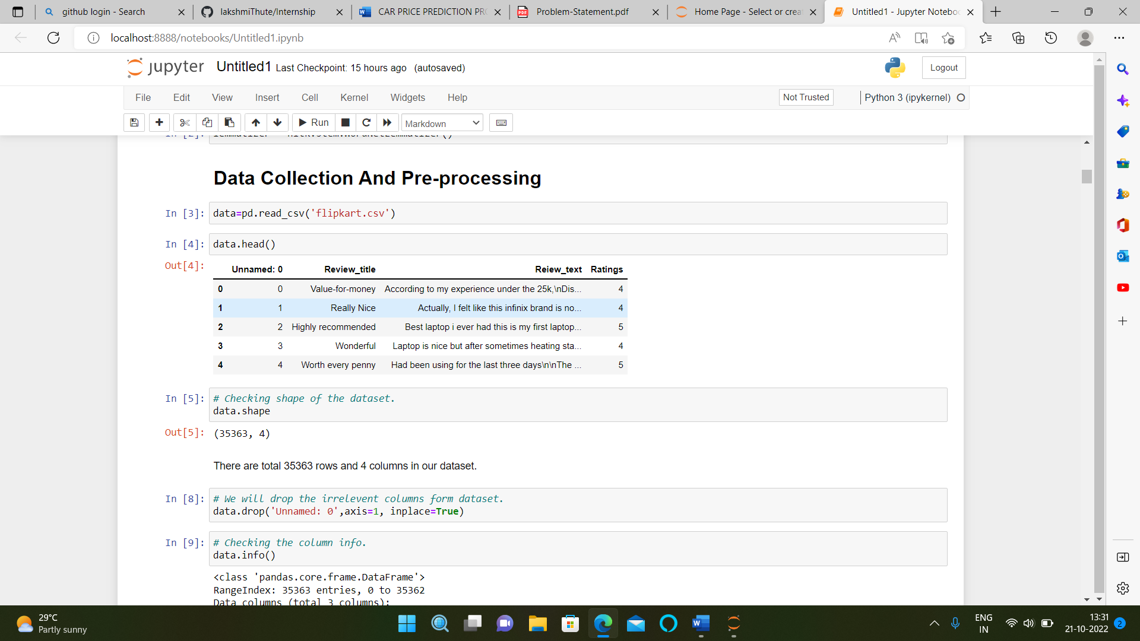
ANALYTICAL PROBLEM FRAMING
• Mathematical/ Analytical Modelling of the Problem
Here I have scraped the ratings data from different e-commerce websites then did the Data Pre-processing using NLP, Exploratory Data Analysis, then Encoding and lastly model Building and Evaluation.
• Data Sources and their formats
I got the dataset in CSV format, and I read the data in Jupyter Notebook using pandas data frame.

Slide 4
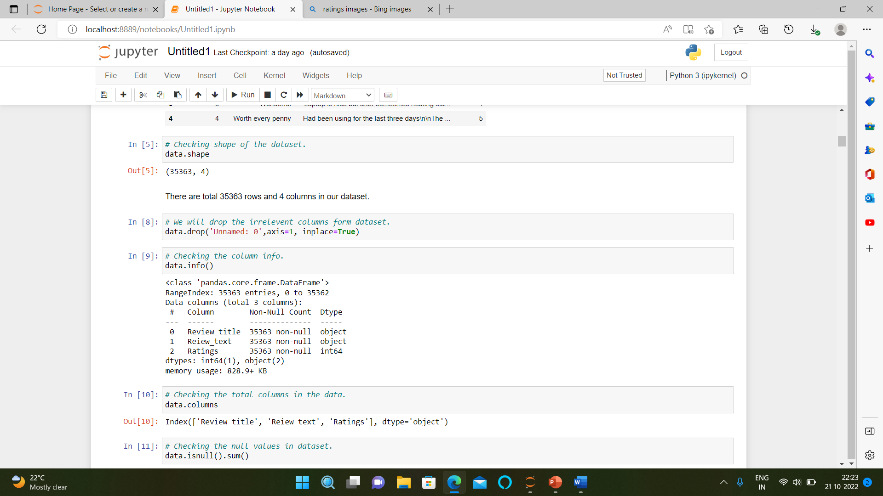
DATA COLLECTION AND PRE-PROCESSING
Data Collection: I have scrapped the data of ratings from different e-commerce websites, then convert the data frame into CSV format and I read the data in Jupyter Notebook using pandas data frame.
Shape of data: The dataset contains total 35363 rows and 4 columns.
Data Summary: The dataset contains 1 integer and 2 object data type columns.
Missing Values: The dataset doesn’t contain any missing values.

Slide 5
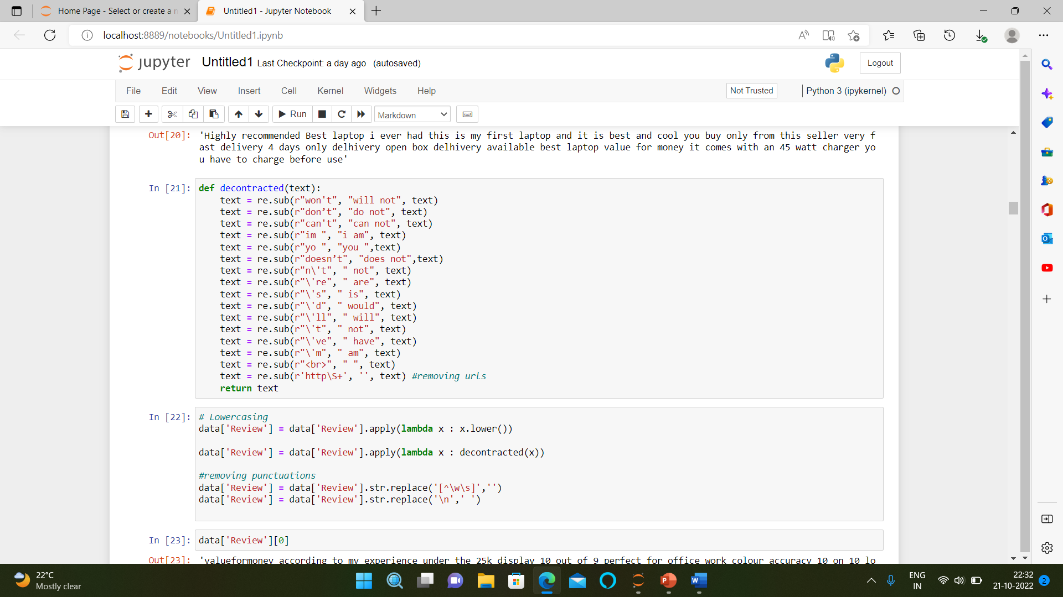
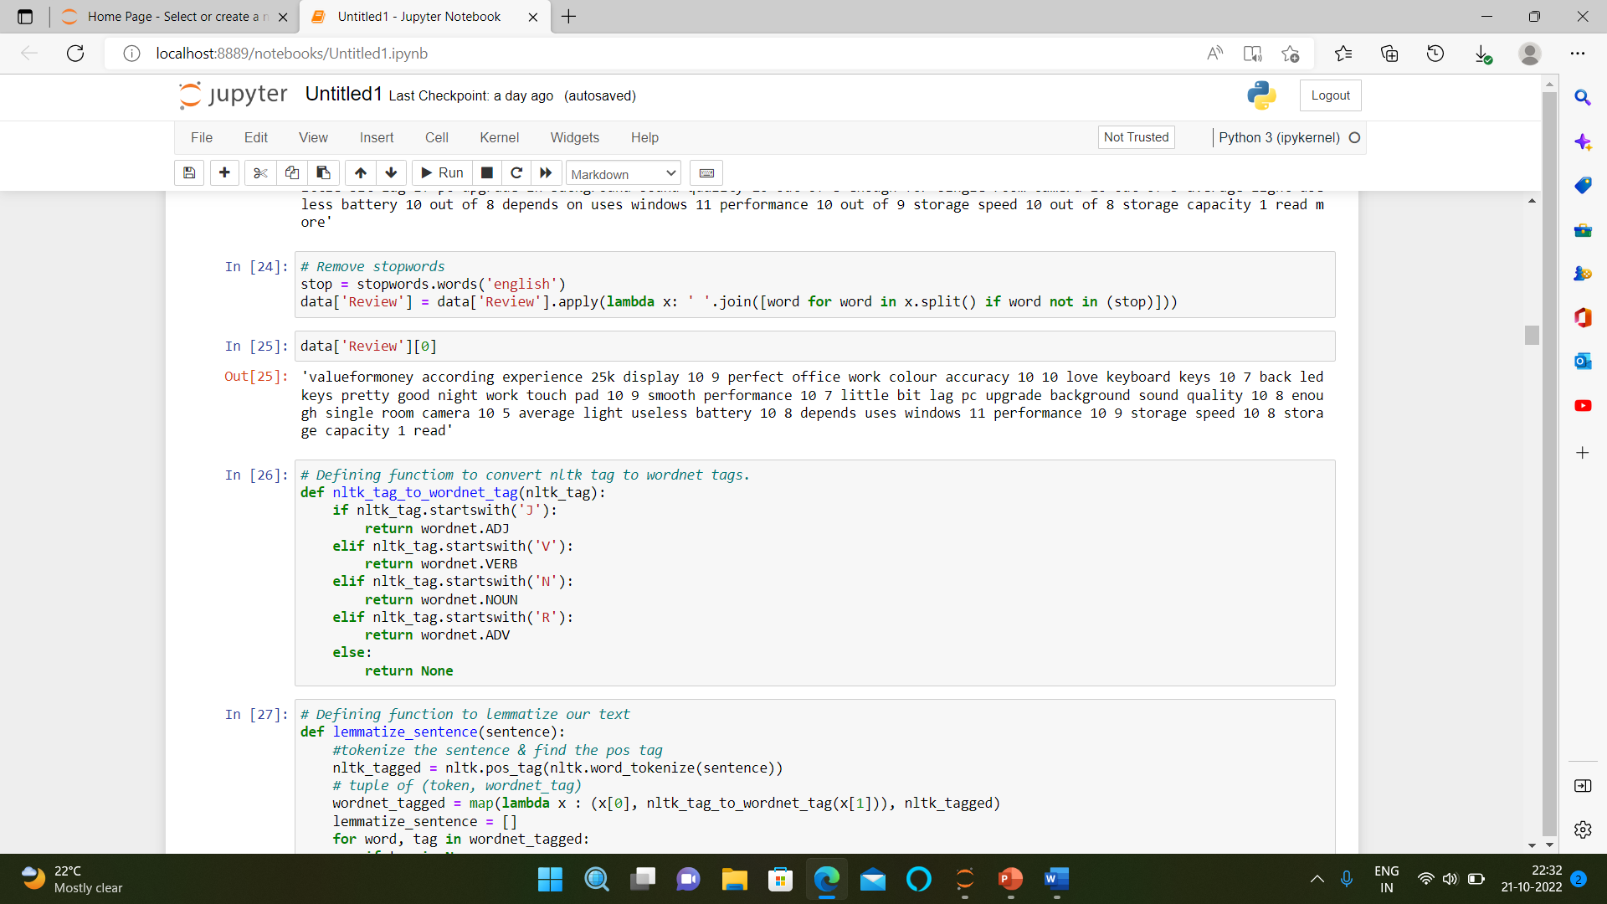
DATA PRE-PROCESSING DONE
Our dataset needs pre-processing and we did it using different modules of NLTK that are tokenization, stemming, lemmatization, stop word removal, etc.

Slide 6
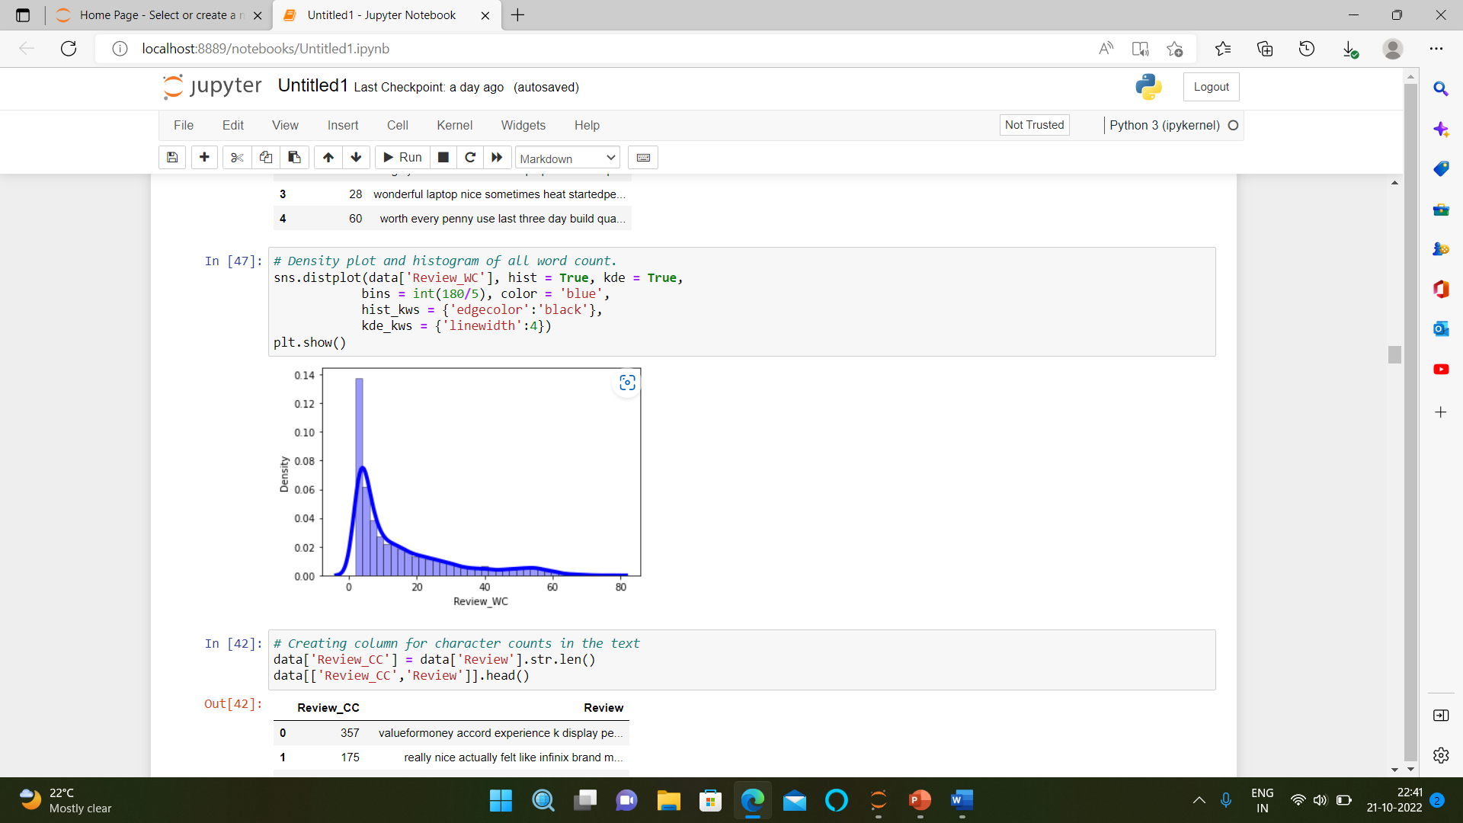
EXPLORATORY DATA ANALYSIS
EDA focuses more narrowly on checking assumptions required for model fitting and hypothesis testing. It also checks while handling missing values and making transformations of variables as needed. EDA build a robust understanding of the data, issues associated with either the info or process. It has a scientific approach to get the story of the data.

Slide 7
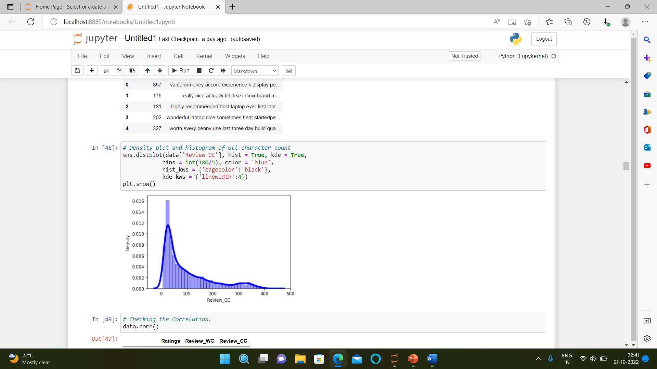

Slide 8
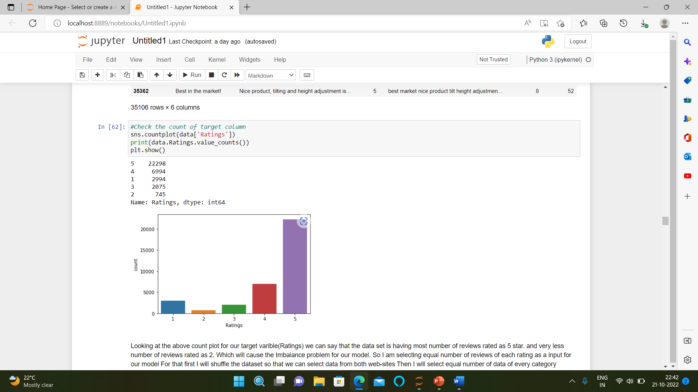

Slide 9
OBSERVATIONS
From the Exploratory data analysis we observed that:
Looking at the above count plot for our target variable(Ratings) we can say that the data set is having most number of reviews rated as 5 star. and very less number of reviews rated as 2. Which will cause the Imbalance problem for our model.
So I am selecting equal number of reviews of each rating as a input for our model For that first I will shuffle the dataset so that we can select data from both web-sites Then I will select equal number of data of every category.

Slide 10
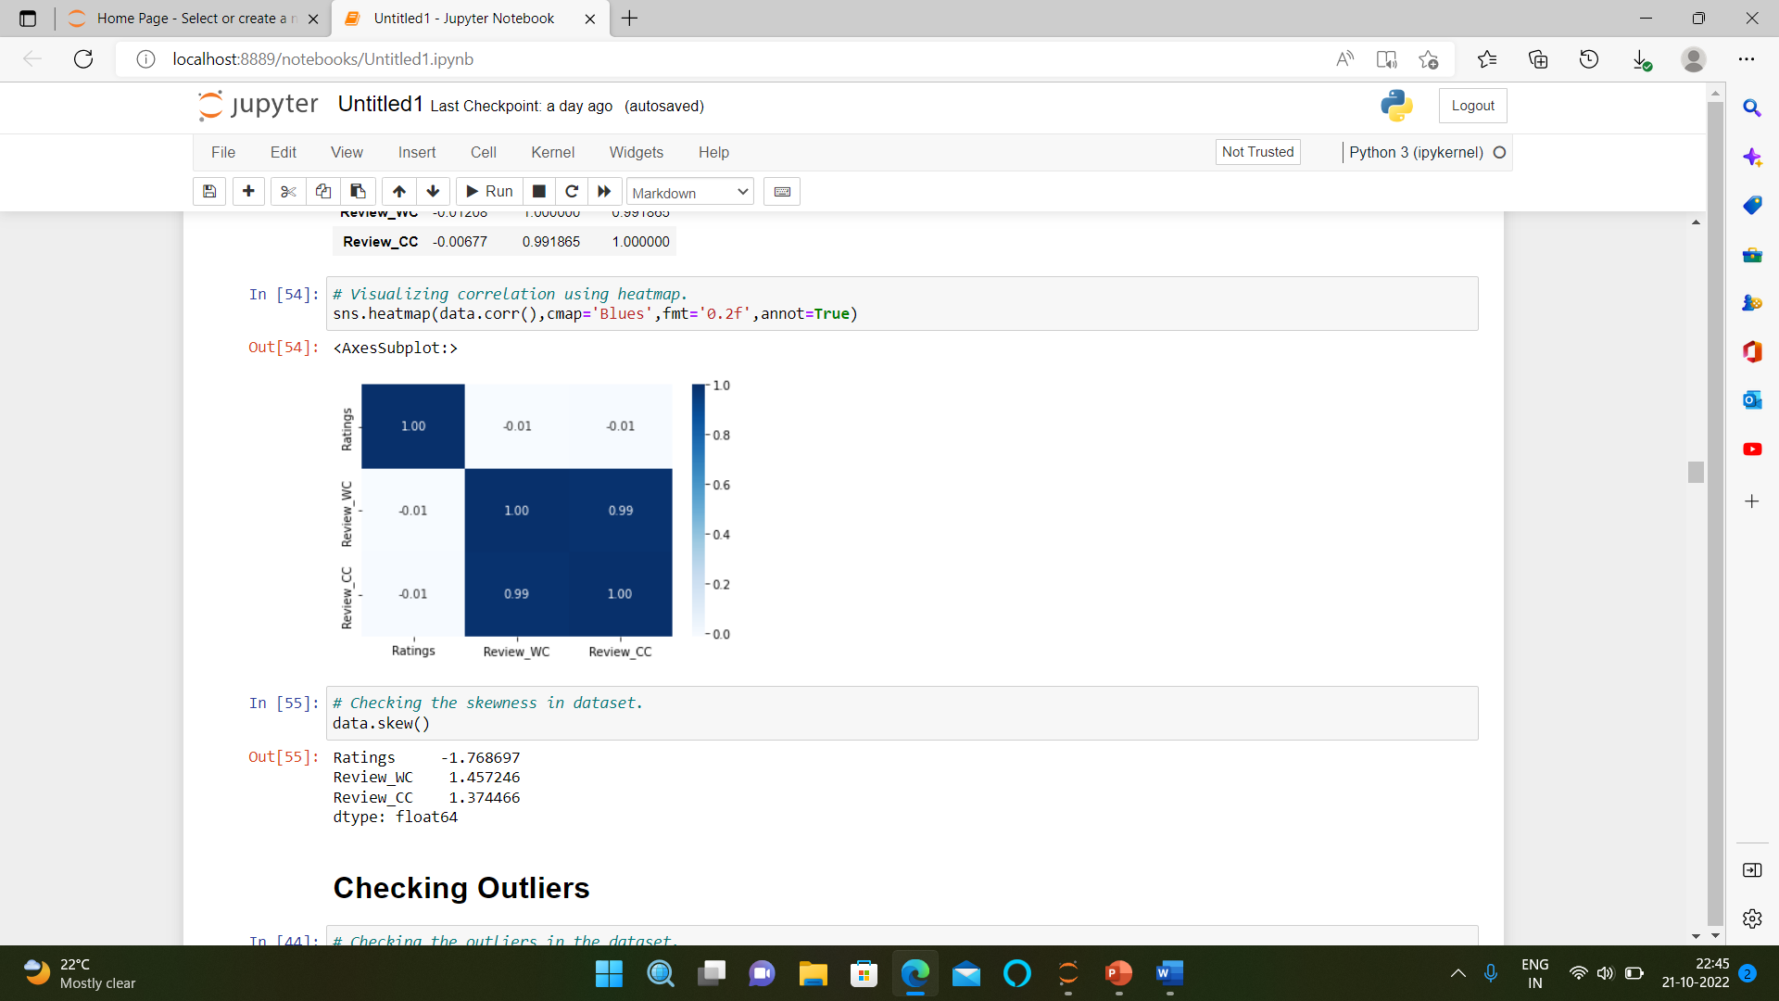
CORRELATION CHECKED
After checking the correlation we understood that the dataset doesn't contain any multicollinearity.

Slide 11
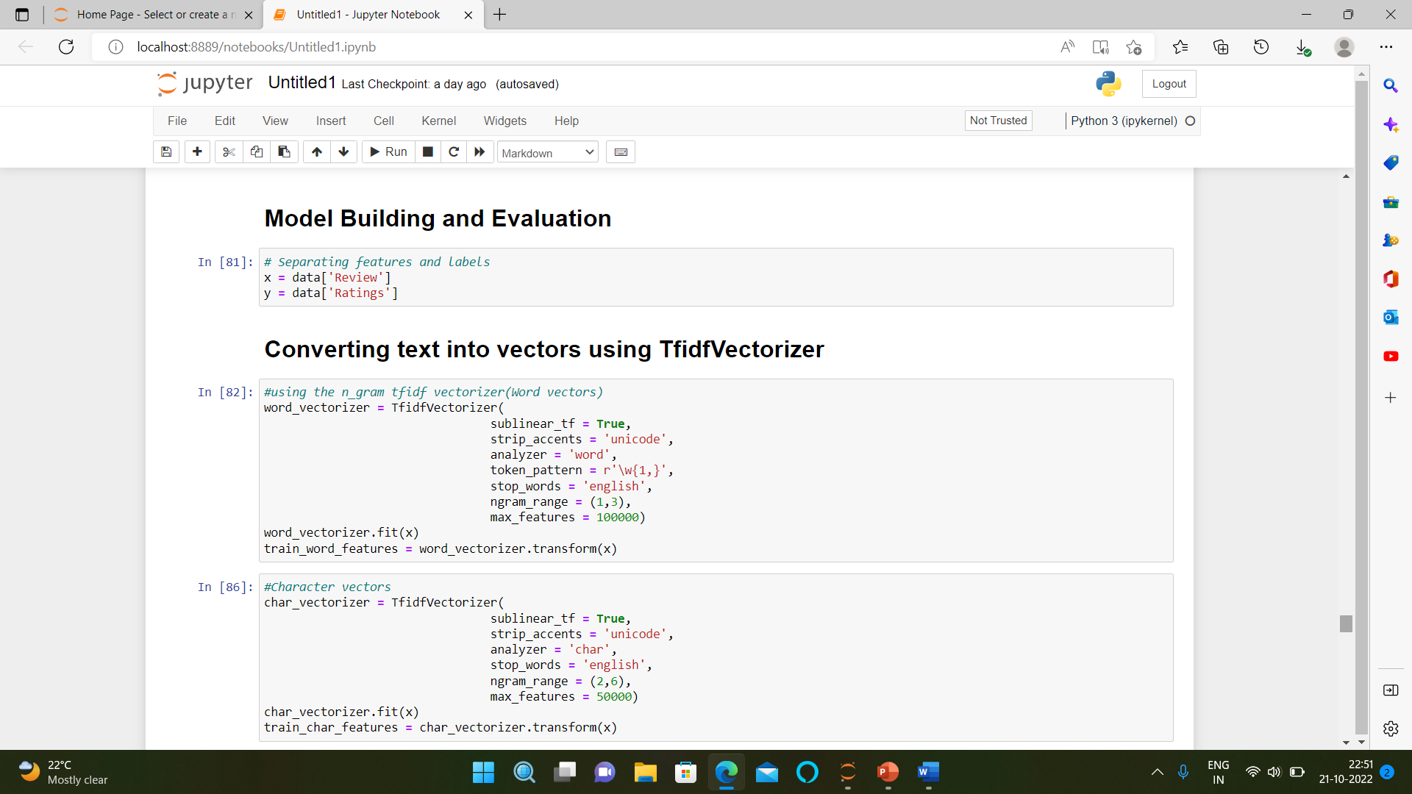
MODEL BUILDING AND EVALUATION

Slide 12
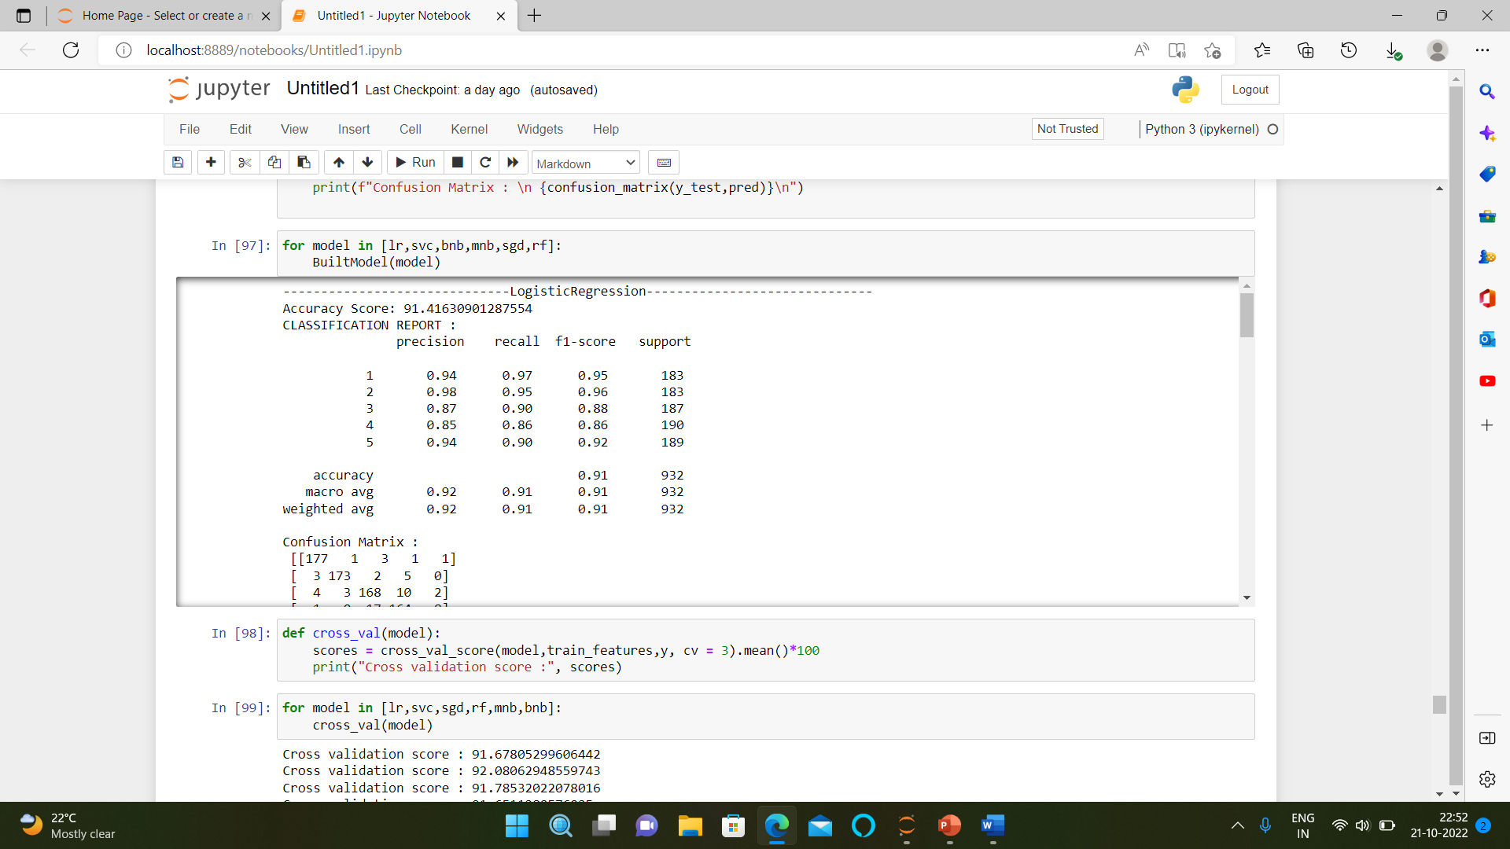

Slide 13
INTERPRETATION OF THE RESULTS
Here after pre-processing we get the data encoded for framing the model and after visualization, we observe that the data does not contain skewness. After checking correlation, we observe that the dataset doesn’t contain multicollinearity. After data pre-processing and EDA we build 6 different algorithms for dataset and from them Linear SVC algorithm perform very well, Lastly we perform hyper parameter tunning to enhance the accuracy. Here we finalise Linear SVC as our best fit model.

Slide 14
THANK YOU

